Slide 1



MICROCONTROLLER BASED SYSTEM DESIGN
CSE 3215
Lecture 1

Slide 2
Embedded systems
The basic idea of an embedded system is a simple one. If we take any engineering product that needs control, and if a computer is incorporated within that product to undertake the control, then we have an embedded system.
Embedded systems are computer based systems that do not appear to be computers – complexity is hidden from the user. Most people, after all, recognize computers by their screen, keyboard, disc drives and so on. This embedded computer would have none of those.
An embedded system is an electronic system that uses a CPU chip but that is not general purpose
work station. It uses microcontroller or microprocessor or custom design chip.

Slide 3
Embedded systems
These days embedded systems are everywhere, appearing in the home, office, factory, car or hospital.
Home | Office and commerce | Motor car
Washing machine | Photocopier | Door mechanism
Answering machines | Printer | Engine control
Microwave | Scanner | Brakes
Central heating controller | Fax machine | In-car entertainment
Sewing machines | Security systems | Air bag
Table1: Some familiar examples of embedded systems

Slide 4
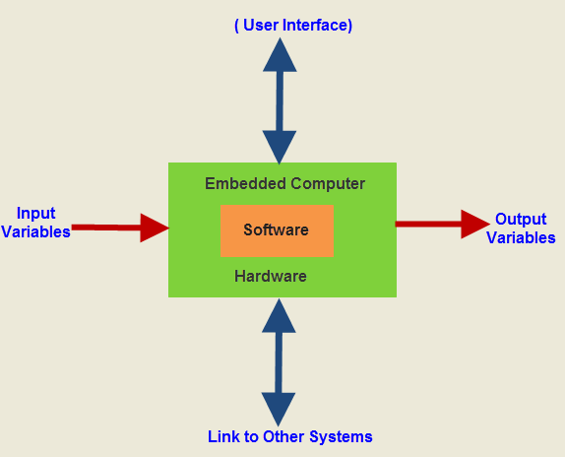
Embedded systems
A basic block diagram of embedded system

Slide 5
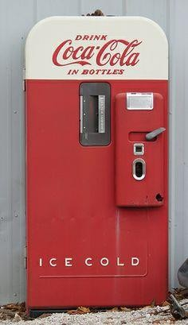
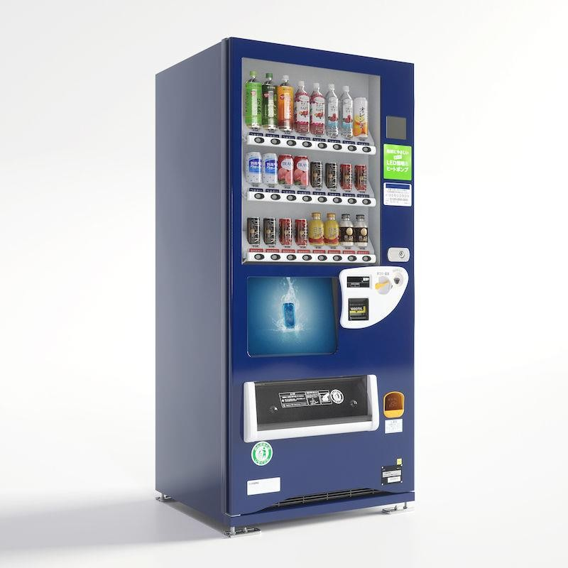
Vending Machine

Slide 6
Embedded systems
Common characteristics of embedded systems
Single functioned:
Executes a single program repeatedly.
Tightly constrained:
Low cost, low power, small, fast and so on.
Reactive and real time:
Continually reacts to changes in the system’s environment.
Must compute certain results in real time, without delay.

Slide 7
Real-time Systems
Real time systems will guarantee to give a result within a specified time. There are two kinds of real-time systems:
Hard real-time systems:
After the delay has passed the result is totally useless (and considered to be an error). No
matter what happens, hard-real time systems deliver the result in the specified time.
Real world examples are the controller for the airbag in a car. The reaction time of an airbag system is around 1 ms.
Another example for a hard real-time system is the Anti-lock braking system in a car. If it does not react fast enough, an accident will occur. People might die because the result was not there fast enough.

Slide 8
Real-time Systems
Soft real-time systems:
On average, these systems work fast enough to make it feel like real-time.
A videoconferencing system has microseconds to record sound and video, to send them to the other party, and to process the incoming data.
If at one time, this cannot be done, the video will be blurred, and the sound may be out of sync for a few moments. This is however not a catastrophe, and the system can continue to work.

Slide 9
Microcontroller
A microcontroller is basically a computer on a chip.
A microcontroller is a compact integrated circuit designed to govern a specific operation in an embedded system.
A typical microcontroller includes a processor, memory and input/output (I/O) peripherals on a single
chip.
Difference between a desktop and microcontroller is that a microcontroller is an application specific computer that usually runs a single program performing dedicated task(s) while a desktop or laptop is general purpose computer that can run numerous programs depending on user needs.

Slide 10
Microprocessor
A microprocessor is basically a CPU on a chip.
A microprocessor is an integrated circuit (IC) which incorporates core functions of a computer’s
central processing unit (CPU).
One has to add memory, clock, input/output interfaces and all other needed peripherals to build one
complete system.

Slide 11
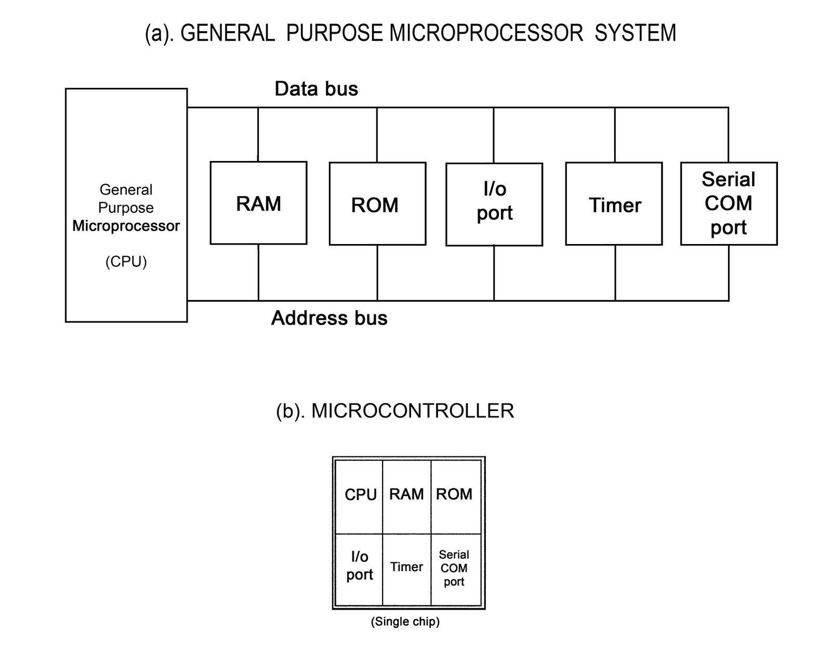
Microcontroller VS Microprocessor

Slide 12
Microcontroller VS Microprocessor
Microcontroller | Microprocessor
Computer on a chip | CPU on a chip
Used in automatically controlled devices. | Mainly used in designing general purpose systems.
Less computation capacity compared to microprocessors. | Computation capacity is very high.
Usually used for simpler tasks. | Can perform complex tasks.
Microcontroller based systems can perform single or very few tasks. | Microprocessor based systems can perform numerous tasks.

Slide 13
Microcontroller VS Microprocessor
Microcontroller | Microprocessor
No need for external components to make a system. | For a complete system, external components need to be connected.
Less costly. | Overall system cost is high.
Less power consumption. | Higher power consumption.
Lower clock frequency, usually in MHz. | Higher clock frequency, usually in GHz.
Use more special function registers. | Use less special function registers.

Slide 14
Microcontroller Applications
Application of Microcontroller in Day to Day Life Devices:
Light sensing & controlling devices
Temperature sensing and controlling devices
Fire detection & safety devices
Industrial instrumentation devices
Process control devices

Slide 15
Microcontroller Applications
Application of Microcontroller in Industrial Control Devices:
Industrial instrumentation devices
Process control devices
Application of Microcontroller in Metering & Measurement Devices:
Volt Meter
Measuring revolving objects
Current meter
Hand-held metering systems

Slide 16
Characteristics of Microcontroller
I/O intensive, i.e. they are capable of direct interface to a significant number of sensors and actuators.
A high level of integration with many peripheral devices.
Physically small.
Comparatively simple program and data storage requirements.
Ability to operate in real time environment.
Optimized instruction sets.
Low cost and power consumption.

Slide 17

THANK YOU

